Slide 1


Project Presentation (PCS25-12) (Placement Module)
KIET Group of Institutions, Ghaziabad
(An ISO – 9001: 2008 Certified & ‘A+’ Grade accredited Institution by NAAC)
Guide Name: Prof. Anurag Mishra
Ujjwal Soni (2100290120179)
Akash Pandey (2200290129003)
Praveen Kumar Yadav(2200290129014)
Aditya Narayan Yadav (2200290129002)

Slide 2
Problem Statement
In colleges the records were stored in excel sheets hence sorting the data is always a problem. The excel sheets are also less advanced. Hence sorting and searching problems arises.
Updating Records is another tedious task. Due to the above problems the updating was very difficult and ambiguous. Data redundancy also occurs due to the duplication of files and records. Hence searching the eligible students was the greatest problem. The placement officer has to find out the eligible students by looking at the excel sheet. He/she has to see the marks of every student and their eligibility.
There is no integrated feedback mechanism to improve the placement process based on student and recruiter input.

Slide 3
Objectives
The main objective of the placement management system is to reduce manual work and time. It is difficult and time-consuming to collect all the details from each student. To avoid this problem we have planned to develop a web-based placement management system.
It manages the details of student records, placement training, different placements happening in and out of the college.
Feedback Mechanism: To help future applicants prepare, allow placed students to offer their opinions on the questions and interview rounds.
Effective Placement Management: Ensure that every student's record is correct and up to date by streamlining the placement management process.
Improved Preparation: To help students prepare more effectively for placement interviews, give them access to recent corporate drive question trends.

Slide 4
Technology Used
Domain – Full Stack.
Front end – HTML, CSS, JavaScript, Bootstrap, Tailwind CSS.
Backend –Node.js, Express.js, SQL, REST API.

Slide 5
SDG Mapping
SDG | Goal Name | Justification
SDG 4 | Quality Education | Enhances student employability by organizing placement opportunities and training resources. Promotes equal access to career advancement tools.
SDG 8 | Decent Work and Economic Growth | Facilitates job placement by connecting students with companies. Supports economic growth through youth employment.
SDG 9 | Industry, Innovation, and Infrastructure | Incorporates innovative full stack technologies to modernize the placement infrastructure in educational institutions.

Slide 6
Literature Survey
Paper title- "A Comparative Study of University Placement Modules and Industry Demand’’
Author name- Jame Smith.
Journal Name- Journal of Educational Research
Year of publishing- 2021
Summary of papers- This paper reviews the role of placement modules in enhancing the employability of university graduates. It analyzes the structure of placement modules, the types of placements offered, and how well they align with industry requirements. The paper concludes that students who engage in structured placement modules demonstrate higher job readiness and adaptability, making them more competitive in the job market.

Slide 7
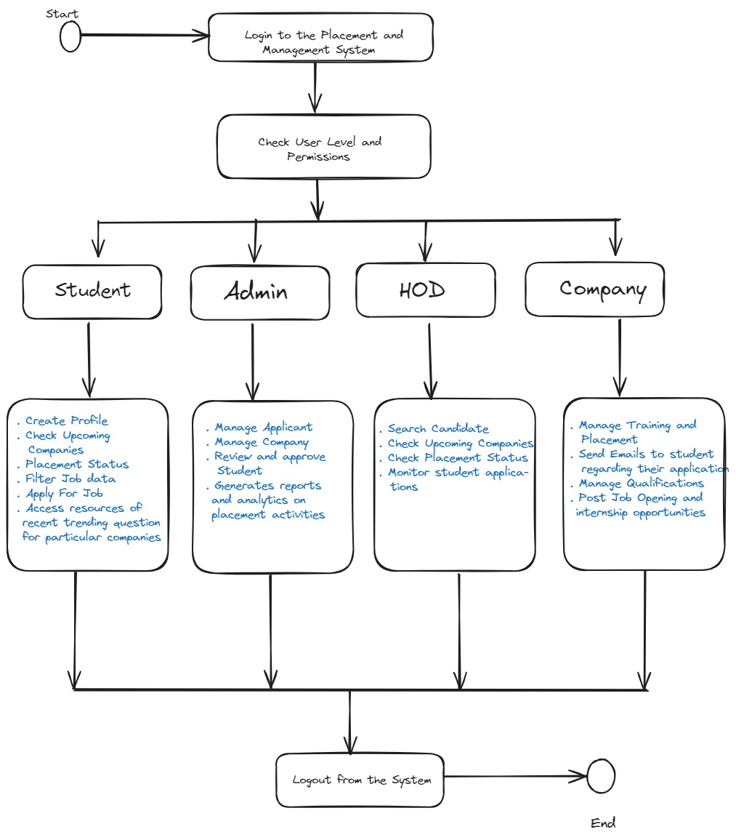
Workflow Diagram

Slide 8
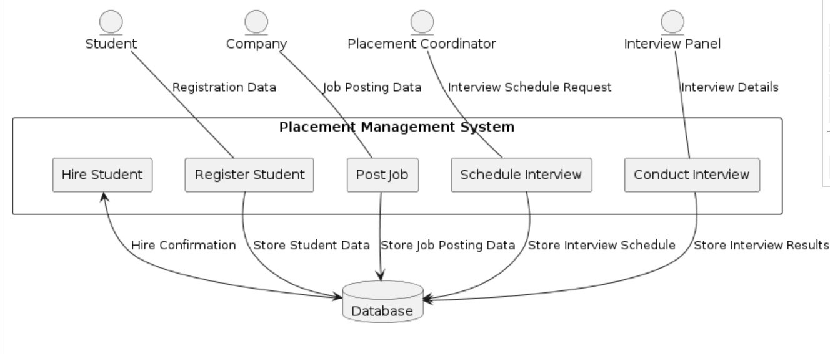
Data Flow Diagram

Slide 9
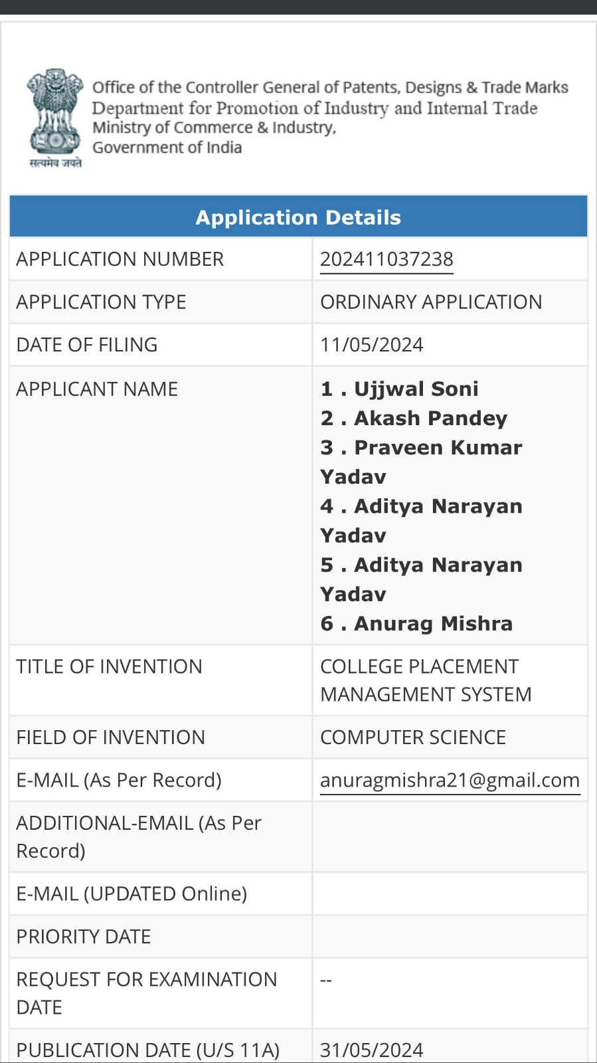
Patent Status

Slide 10
Research Paper Status
Soft copy proof of submission/ publication.
Draft completion status

Slide 11
Project Status
How much project is completed with screenshot of the output domains.
Working project

Slide 12
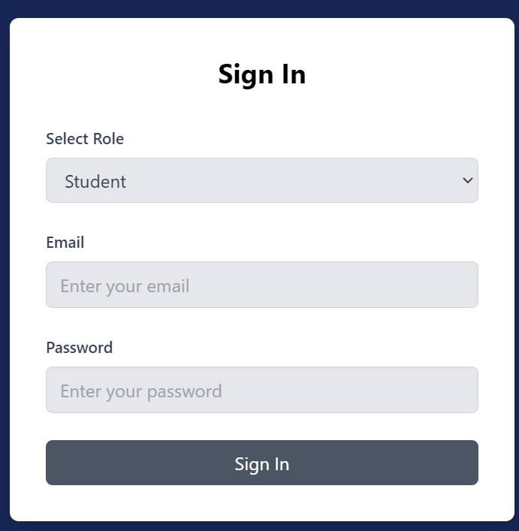

Slide 13
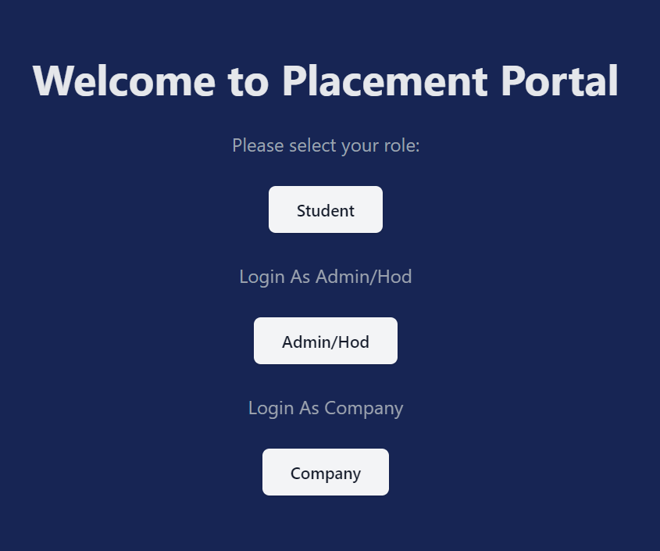

Slide 14
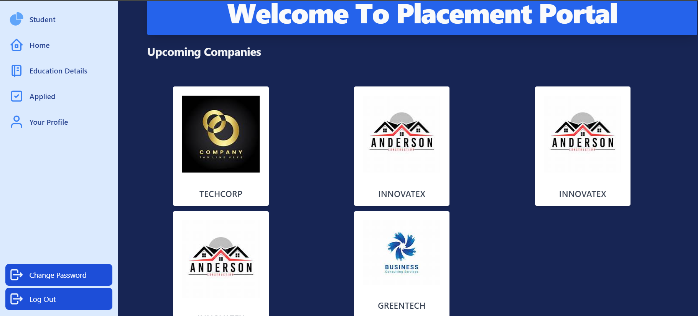

Slide 15
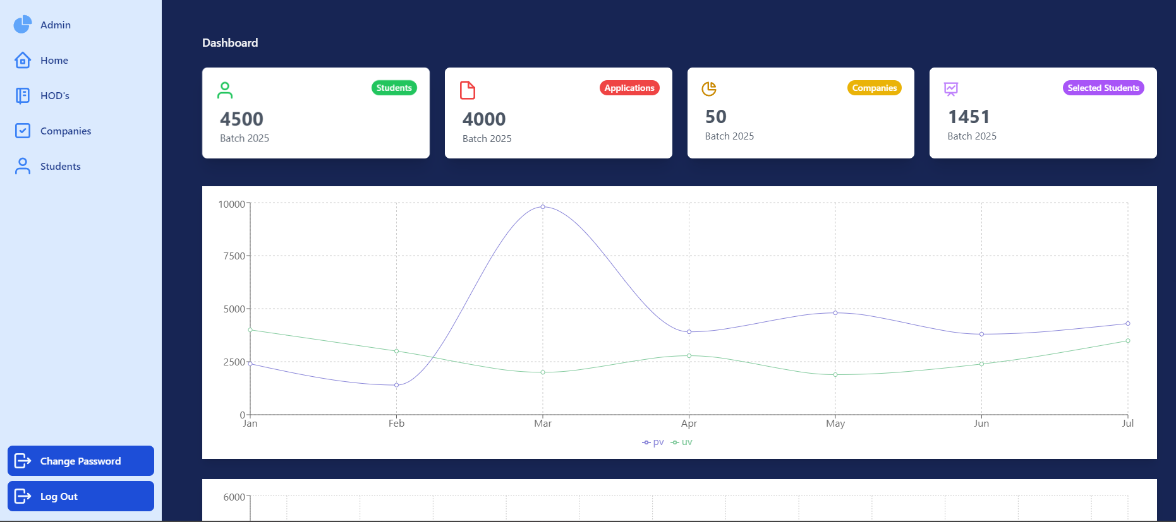

Slide 16
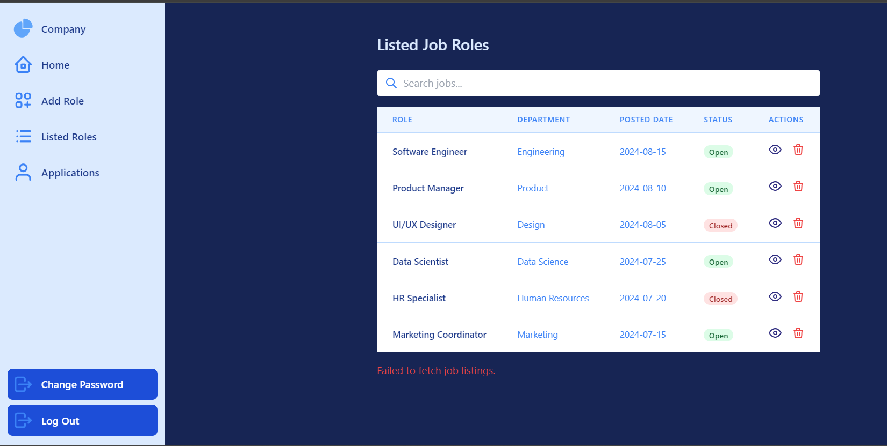

Slide 17
References
J. Smith, “A Comparative Study of University Placement Modules and Industry Demand,” Journal of Educational Research, vol. 18, no. 2, pp. 45–52, 2021.
M. Singh and R. Verma, “Web-Based Campus Recruitment Systems: An Overview,” International Journal of Computer Applications, vol. 176, no. 26, pp. 20–24, 2020.
World Bank, “Digital Skills: Critical for Jobs and Development,” World Bank Report, 2020. [Online]. Available: https://www.worldbank.org/en/topic/digitaldevelopment/brief/digital-skills-critical-for-jobs-and-development

